Slide 1
Weekly Review
Sept. 1st 2022

Slide 2
Duolingo
Trey Floto (フロートさん)
69 Day Streak
Mr. Smith (スミス先生)
Won the Diamond Tournament
Shame (please point and laugh)
Riley Rorrer
Jacob Smith
Jayson Ziegler
Building good routines is critical to an easy, maintainable life

Slide 3
Task List Assessment
Three parts:
What was the contribution? (What repo? What PR? What Issue? What discussion? Use # links)
You were given a Task List of all the Items you need to know before graduating. Where is it? Each item is numbered.
Explain why you think the things you did THIS WEEK prove that you understand each item you chose.

Slide 4
Best Example of Contribution
Ethan Shimmel submitted PR #7 on csmith1188/Formbar.js
‘node_modules’ folder was in the ‘.gitignore’ and not uploaded
Started Discussion #8 in csmith1188/Formbar.js
Next time make this an Issue. It’s an obvious goal anyone can work towards.
Work was done in his own branch in his own fork, then the PR was sent to the upstream’s DEV branch
Please take time after this Weekly Review to look at these examples on Github.

Slide 5
Best Example of Documentation
“Best” is not necessarily “good”
Christian Boldt and Jaysin Haugh
Told me the repo and # link for their contribution
Listed three Task List Item Numbers
Cited specific lines of code that were examples of those Task List Items
In the future:
Submitting the same PR is messy. If your work is in someone else’s PR, please give me some commit codes
Please explain why those lines of code relate to the Task List Item so that I know you know what you’re talking about.
Please take time after this Weekly Review to ask if you can see their DocPacs

Slide 6
Documentation
If it’s not written down, it doesn’t exist.
Diplomas, Certifications, Pay Checks, Receipts, Driver’s Licenses, Degrees, Birth Certificate, Voter Registration, Bills
I can’t remember all of the discussions we had about your assignments. This is why documenting stuff is important!

Slide 7
Reflections
“I’m worried about learning Javascript”
It’s just Python with curly braces
“What was a problem? How do you fix it?”
I need a specific plan
“I didn’t study, so I will study more” is not an answer and I’ve already said this
“I will complete one 15 minute Youtube tutorial in the evening on each A day” is a plan and a measurable solution.
I asked how to remove 37 nails from a tire.
Replacing the tire was not in the question. What if I needed 37 nails?
Attention to details and instructions is critical for computer programming
How much longer can we continue to solve problems by throwing away old things and buying new replacements?

Slide 8
Best Example of Reflections
John Eckert
Specific problems with Specific solutions
Not necessarily measurable but show foresight
Someone said “Burn the tire so only the nails remain”
Trey Floto
var nails = 37;
while (nails > 0) {
nails = nails - 1;
}
Please take time to see their reflections after this review.

Slide 9
Juniors not turning in DocPacs
What’s the worst day of the week to miss school?
What’s the second worst day of the week to miss school?
Seniors whose grades depended on the Junior turning in a DocPac but was absent, your grade will go up when I get their DocPac
Please see me if it is not changed by the end of next week

Slide 10
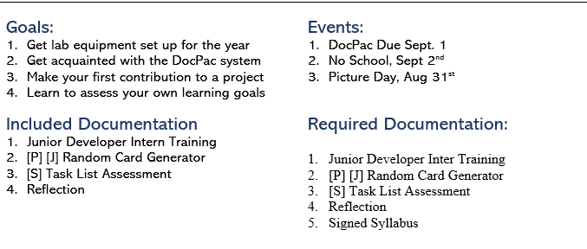
Solving DocPac Issues
Jaysin Haugh solved #13 with PR #22
Next time
Use Format Painter in Word to match font/style/layout
Put “Fixed #13” in the PR description

Slide 11
ExpressJS Server Parts
It’s hard to Google stuff if you don’t know what it’s called
It would be great if someone started compiling a vocab list with definitions
It would be better if we could get those into the Formbar Hangman game
Don’t ignore things that I write in your DocPac
It took me five hours just to grade and write this Review
If I wrote it in your DocPac, take time to do something with it
Google the words I write!
You were supposed to write the Task List Item number in each box.
Please follow instructions carefully
Riley Rorrer receives Pogs for completing this assignment as bonus

Slide 12
The Plan
Seniors will show Juniors how the DocPac binders work
Seniors will archive their old DocPac Binders
Seniors will have their Juniors develop their Portfolios
Seniors will continue working on their projects
Mr. Smith will continue working with Juniors
Juniors may have more assignments forthcoming

